Slide 1
Module 1 Arrays

Slide 2
Arrays
Arrays are a collection of variables of the same data type. To declare an array, we can use the following:
int[] arr1; //declaration form #1
arr1 = new int[100]; //instantiation
int arr2[]; //declaration form #2
arr2 = new int[100]; //instantiation
int[] arr3 = new int[20]; //declaration and instatiation form #3
int arr4[] = new int[20]; //declaration and instatiation form #4

Slide 3
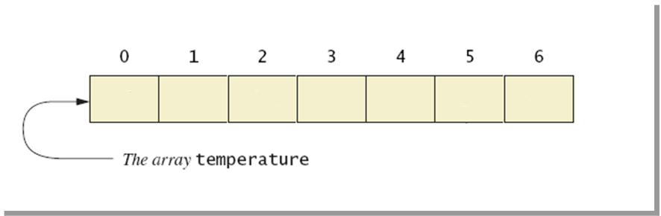
Visualizing Arrays
double[] temperature = new double[7];

Slide 4
Syntax
All array positions have to be of the same type. We cannot mix Strings, integers or doubles on the same array.
data_type[] array_name = new data_type[array_size];
data_type array_name[] = new data_type[array_size];
The array size needs to be a positive number greater than or equal to 0.

Slide 5
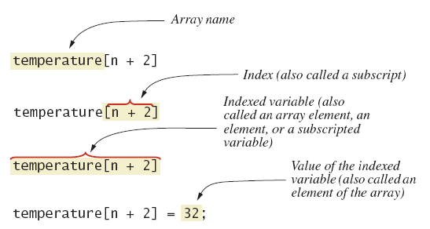
Nomenclature

Slide 6
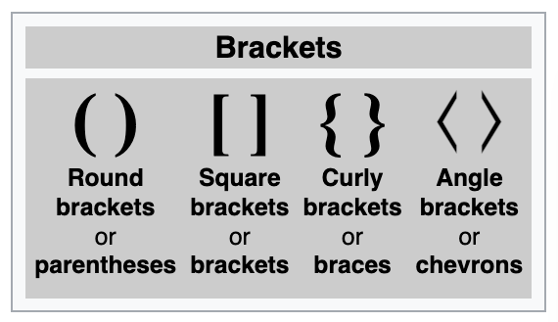
Brackets

Slide 7
Accessing array positions
To access the element of an array, we use square brackets [].
The first position of an array will always be index 0, and the last one will be array_name.length – 1.
double[] temperature = new double[7];
temperature[0] = 6.9; //first element index 0
temperature[1] = 30;
temperature[2] = 25.7;
temperature[3] = 26;
temperature[4] = 34;
temperature[5] = 31.5;
temperature[6] = 29; //last element index (temperature.length-1)
//temperature[temperature.length-1] = 29;

Slide 8
Accesing array positions
We can initialize an array in two ways:
Instantiating the array with the new operator, then filling each position.
Implicit instantiation with all array values
1
double[] temperature = new double[7];
temperature[0] = 6.9;
temperature[1] = 30;
temperature[2] = 25.7;
temperature[3] = 26;
temperature[4] = 34;
temperature[5] = 31.5;
temperature[6] = 29;
2
double[] temperature = {6.9, 30, 25.7, 26, 34, 31.5, 29};

Slide 9
Array size
To find the size of the array, we can use the length attribute.
The length of the array is a final attribute, it can never be changed changed.
double[] temperature = new double[7];
int len = temperature.length;
System.out.println(len); //prints 7
The last element of an array will always be length - 1.
temperature[temperature.length - 1] = 29;

Slide 10
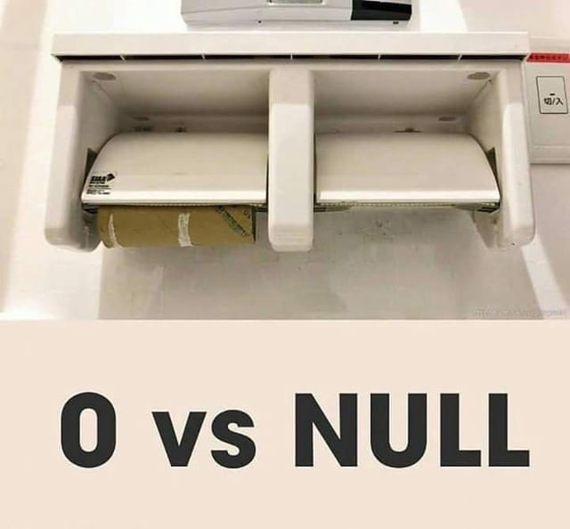
Array size
What would be the size of the following arrays?
double[] array1 = new double[10];
double[] array2 = new double[0];
double[] array3;
Answer:
array1 has a size of 10
array2 has a size of 0
array3 is null, it has no size

Slide 11
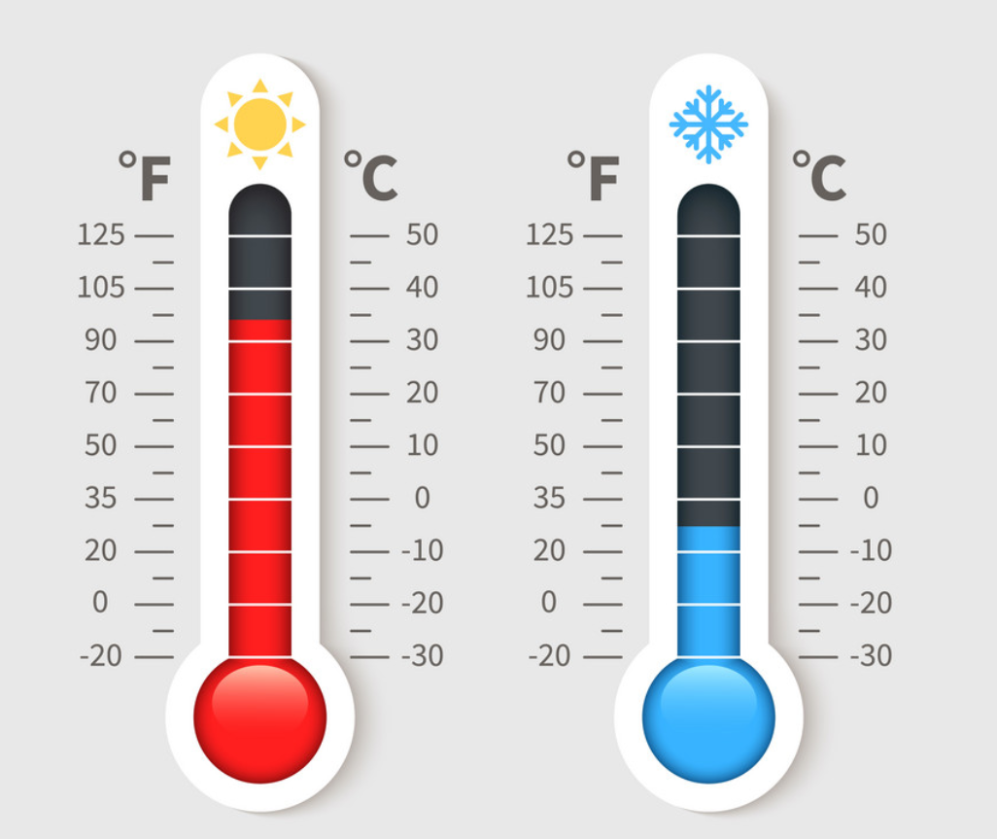



Exercise!
Build a program that can read 7 temperatures from the keyboard. Then it should calculate the average temperature and show which temperatures are above and below the average.

Slide 12
import java.util.*;
public class ArrayOfTemperatures {
public static void main(String[] args) throws Exception {
double[] temperatures = new double[7]; Scanner keyboard = new Scanner(System.in);
System.out.println("Enter 7 temperatures");
double sum = 0; for(int i=0; i<temperatures.length; i++){
temperatures[i] = keyboard.nextDouble();
sum = sum + temperatures[i];
}
double average = sum / 7;
System.out.println("The average is: " + average); System.out.println("The temperatures are:");
for(int i=0; i<temperatures.length; i++){
if (temperatures[i] > average){
System.out.println(temperatures[i] + " is above average.");
}
if (temperatures[i] < average){
System.out.println(temperatures[i] + " is below average.");
}
if (temperatures[i] == average){
System.out.println(temperatures[i] + " is the average.");
}
} keyboard.close();
}
}

Slide 13
Arrays are objects
Arrays are objects, which means that when we reference it we are actually trying to read the memory location where the object is stored.
Let’s look at an example:

Slide 14
double[] a;
10F50
a
null
10F51
Memory location
10F52
10F53
When declaring variable a, and it
is stored in 10F51

Slide 15
double[] a;
a = new double[5];
2C7F0
a[0]
0.0
a[1]
0.0
a[2]
0.0
10F50
a[3]
0.0
a
2C7F0
10F51
a[4]
0.0
10F52
10F53
We create a new array of size 5.
The array starts in memory position
2C7F0.

Slide 16
double[] a;
a = new double[5];
a[0] = Math.random();
a[1] = Math.random();
a[2] = Math.random();
a[3] = Math.random();
a[4] = Math.random();
2C7F0
a[0]
0.76
a[1]
0.16
a[2]
.99
10F50
a[3]
.15
a
2C7F0
10F51
a[4]
.03
10F52
10F53
Fill array with random values

Slide 17
Morse code

Slide 18
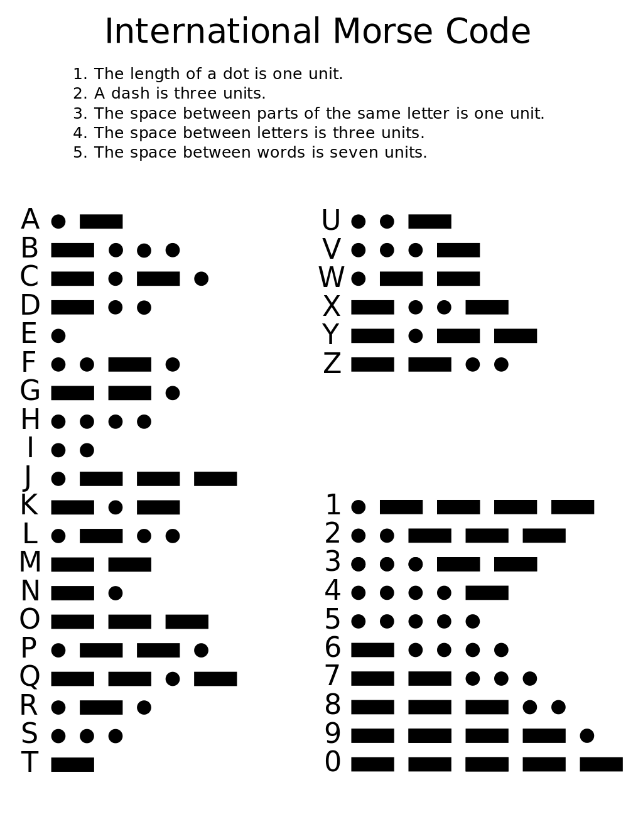

Slide 19
Design a program that reads a positive integer number and converts it to morse code.
Each digit will be separated by a space. For example:
Number 13, will result in:
.---- …--

